Slide 1
Deep Learning and Machine Vision for Architectural Design Seminar series

Slide 2
Demystifying Deep Learning
Basic mathematical overview of deep neural networks
The importance of training data

Slide 3
The anatomy of a neural network
Connections
Input Layer
Hidden Layers
Output Layer
Notes:
A neural network is a computing system made up of a number of simple, highly interconnected processing elements (called nodes) that transform information based on their response to external inputs.

Slide 4
The anatomy of a neural network
Connections
Input Layer
Hidden Layers
Output Layer
Nodes: One computational unit that transforms input to output
Layers: Collection of nodes that are not interconnected
Connections: Projections from neurons in one layer to neurons in the next layer
Notes:
A neural network is a computing system made up of a number of simple, highly interconnected processing elements (called nodes) that transform information based on their response to external inputs.
Note that this network is a fully connected network, which means that each node has a connection to each neuron in the previous layer and each neuron in the next layer

Slide 5
The anatomy of a neural network
Connections
EXAMPLE:
X
Y
Z
CAR
Input Layer
Hidden Layers
Output Layer
Nodes: One computational unit that transforms input to output
Layers: Collection of nodes that are not interconnected
Connections: Projections from neurons in one layer to neurons in the next layer
Notes:
To understand how information is processed by these algorithms, lets consider this EXAMPLE
Input could be a spatial location/point x,y,z in the world, output could be what object exists at that point

Slide 6
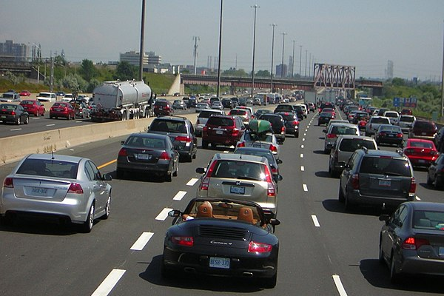
Information Processing in a VERY Simple Neural network
Problem:
Detecting if a driver is drunk.
Given an X ‘swerviness’ of a car, is the driver drunk?

Slide 7

Information Processing in a VERY Simple Neural network
Node₁
w₁
X
$$\left({0 \atop 1}\right)$$
Notes:
For this problem lets consider a single node neural network
Given an input vector, (x,y), we want the neural network to output either a 0 or a 1, where a 1 indicates a car is in fact at that location, or a 0, indicating that a car is not at that location. This is a binary classification problem, where we are trying to distinguish between two classes.

Slide 8
Information Processing in a VERY Simple Neural network
Node₁
w₁
X
$$\left({0 \atop 1}\right)$$
Node₁ = f(w₁X + b)
Notes:
The way that node1 processes information:
First node in first hidden layer would take in x,y values, multiply by a weight value, a, sum, which becomes its ‘state’/the input to the neurons in the next layer
So each node processes input as a sum of scaled inputs, and then passes this on to all the nodes its connected to in the next layer

Slide 9
Information Processing in a VERY Simple Neural network
Role of Activation Functions:
I. Linear (or None): Output = Node₁ = w₁X + b
Node₁
w₁
X
$$\left({0 \atop 1}\right)$$
Node₁ = f(w₁X + b)
Output
Input
Notes:
From here you can see that the weights control the slope of the decision function, bias shifts it
Linear or Identity Activation Function
As you can see the function is a line or linear. Therefore, the output of the functions will not be confined between any range
as a sum of scaled inputs, and then passes this on to all the nodes its connected to in the next layer.
Range : (-infinity to infinity)

Slide 10
Information Processing in a VERY Simple Neural network
Role of Activation Functions:
I. Linear (or None): Output = Node₁ = w₁X + b
Node₁
w₁
X
$$\left({0 \atop 1}\right)$$
Node₁ = f(w₁X + b)
Output
Input
Notes:
From here you can see that the weights control the slope of the decision function, bias shifts it
Linear or Identity Activation Function
As you can see the function is a line or linear. Therefore, the output of the functions will not be confined between any range
as a sum of scaled inputs, and then passes this on to all the nodes its connected to in the next layer.
Range : (-infinity to infinity)

Slide 11
Information Processing in a VERY Simple Neural network
Node₁ = w₁X + b
Output Y
Data Points
Input X
Notes:
Can we draw a straight line to separate the two classes? Not easily!!! This is why we want nonlinear activation functions

Slide 12
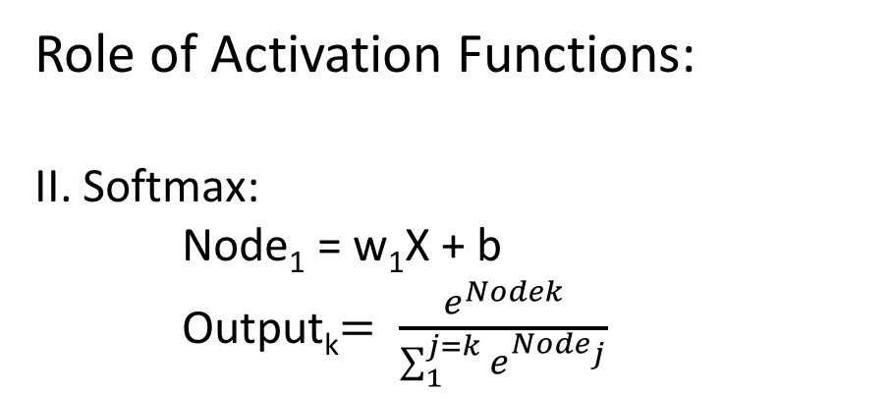
Information Processing in a VERY Simple Neural network
Role of Activation Functions:
II. Softmax: Node₁ = w₁X + b Output_{k}$= \frac{e^{Nodek}}{\sum_{1}^{j=k}{e^{{Node}_{j}}}}$
Node₁
w₁
X
$$\left({0 \atop 1}\right)$$
1
Node₁ = f(w₁X + b)
Output
0
Input X
Notes:
Softmax Activation Function
The Softmax Function curve looks like a S-shape.
The main reason why we use softmax function is because it exists between (0 to 1).
The softmax function takes an un-normalized vector, and normalizes it into a probability distribution.
Therefore, it is especially used for models where we have to predict the probability as an output.
Softmax is often used in neural networks, to map the non-normalized output to a probability distribution over predicted output classes.

Slide 13
Information Processing in a VERY Simple Neural network
Role of Activation Functions:
II. Softmax: Node₁ = w₁X + b Output_{k}$= \frac{e^{Nodek}}{\sum_{1}^{j=k}{e^{{Node}_{j}}}}$
Node₁
w₁
X
$$\left({0 \atop 1}\right)$$
1
Node₁ = f(w₁X + b)
Output
0
Input X
Notes:
Softmax Activation Function
The Softmax Function curve looks like a S-shape.
The main reason why we use softmax function is because it exists between (0 to 1).
The softmax function takes an un-normalized vector, and normalizes it into a probability distribution.
Therefore, it is especially used for models where we have to predict the probability as an output.
Softmax is often used in neural networks, to map the non-normalized output to a probability distribution over predicted output classes.

Slide 14
Information Processing in a VERY Simple Neural network
Role of Activation Functions:
III. Rectified Linear Unit (ReLu): Node₁ = w₁X + b Output = max(0, Node₁)
Node₁
w₁
X
$$\left({0 \atop 1}\right)$$
0
1
Node₁ = f(w₁X + b)
Output
0
Input X
Notes:
Rectified Linear Unit Function
The ReLU is the most used activation function in the world right now. Since, it is used in almost all the convolutional neural networks or deep learning.
Range: [ 0 to infinity)

Slide 15
Information Processing in a VERY Simple Neural network
Role of Activation Functions:
III. Rectified Linear Unit (ReLu): Node₁ = w₁X + b Output = max(0, Node₁)
Node₁
w₁
X
$$\left({0 \atop 1}\right)$$
0
1
Node₁ = f(w₁X + b)
Output
0
Input X
Notes:
Rectified Linear Unit Function
The ReLU is the most used activation function in the world right now. Since, it is used in almost all the convolutional neural networks or deep learning.
Range: [ 0 to infinity)

Slide 16
Information Processing in a VERY Simple Neural network
Output Y
Data Points
Input X
Notes:
But, thanks to the nonlinear activation function, the neural network learns a nonlinear decision boundary, which does a better job of seperating car vs. non car because we can learn arbitrarily complex functions

Slide 17

Information Processing in a VERY Simple Neural network
w₁
Node₁
w₃
X
Node₁
$$\left({0 \atop 1}\right)$$
Node
Output
w₂
w₄
Node₂
Data Points
Input X
Node = f( W₃f( w₁X + b₁ ) + b₃ + W₄f( w₂X + b₂ ) + b₄ )
Notes:
But, thanks to the nonlinear activation function, the neural network learns a nonlinear decision boundary, which does a better job of seperating car vs. non car because we can learn arbitrarily complex functions

Slide 18
Information Processing in a VERY Simple Neural network
How to pick the weights and biases?
We want to maximize the number of times we have a correct prediction given a dataset of inputs and outputs
Node₁
w₁
X
$$\left({0 \atop 1}\right)$$
Training Data:
(X₁, 1 )
(X₂, 0 )
.
.
.
(X_{n-1}0 )
(X_{n}, 1 )
Node₁ = f(w₁X + b)
Notes:
Backpropagation
given initialized weights, input/output pairs (this is a case of supervised learning), we want to learn the values of weights and biases such that we learn the mapping from output to input that yeilds the highest prediction accuracy

Slide 19
Information Processing in a VERY Simple Neural network
How to pick the weights and biases?
First, we need a measure of how good the neural network’s prediction is
This is done with a loss function!
Error = Dist( Output – Ground Truth)
Node₁
w₁
X
$$\left({0 \atop 1}\right)$$
Node₁ = f(w₁X + b)
Notes:
Backpropagation
Choosing the right loss function
A loss function can be thought of as a distance function in the output/label space

Slide 20
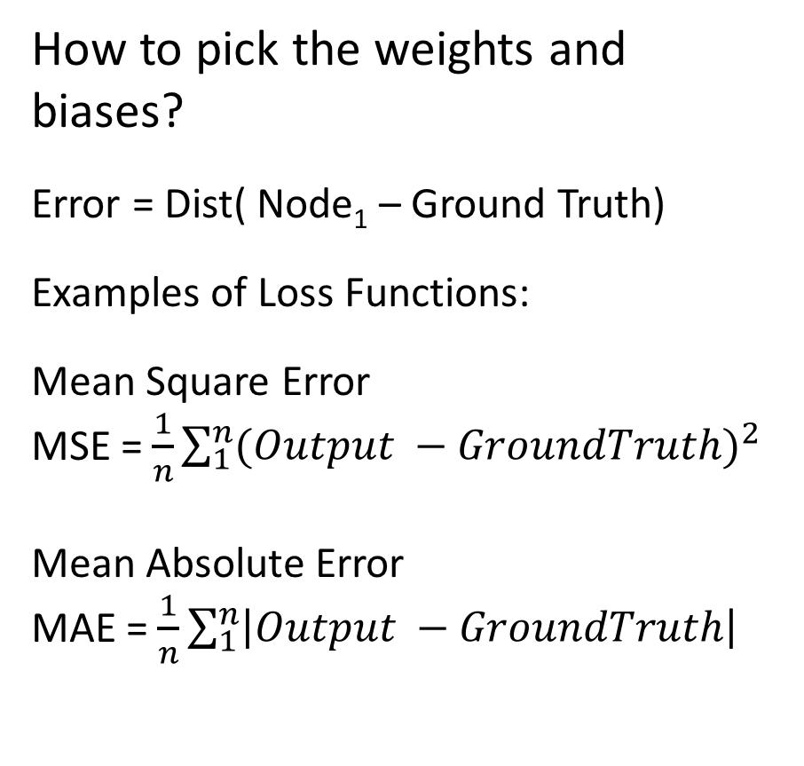
Information Processing in a VERY Simple Neural network
How to pick the weights and biases?
Error = Dist( Node₁ – Ground Truth)
Examples of Loss Functions:
Mean Square Error
MSE = $\frac{1}{n}\sum_{1}^{n}{{(Output −GroundTruth)}^{2}}$
Mean Absolute Error
MAE = $\frac{1}{n}\sum_{1}^{n}{\left|Output −GroundTruth\right|}$
Node₁
w₁
X
$$\left({0 \atop 1}\right)$$
Node₁ = f(w₁X + b)
Notes:
Backpropagation
Because of the square, large errors have relatively greater influence on MSE than do the smaller error. Therefore, MAE is more robust to outliers since it does not make use of square. On the other hand, MSE is more useful if concerning about large errors whose consequences are much bigger than equivalent smaller ones.
L2 is unnormalized MSE, L1 is unnormalized MAE

Slide 21
Information Processing in a VERY Simple Neural network
How to pick the weights and biases?
Error = Dist( Node₁ – Ground Truth)
Now we want to update the weights and biases of the network based upon this Error/loss function
We need a way to relate change in Loss to change in the weights!
Node₁
w₁
X
$$\left({0 \atop 1}\right)$$
Node₁ = f(w₁X + b)
Notes:
Backpropagation

Slide 22
Information Processing in a VERY Simple Neural network
How to pick the weights and biases?
Take the derivative of the loss function with respect to the weights and biases
Node₁
w₁
X
$$\left({0 \atop 1}\right)$$
Node₁ = f(w₁X + b)
Error F^{n}
Output
Error
w
Notes:
Backpropagation

Slide 23
Information Processing in a VERY Simple Neural network
How to pick the weights and biases?
Take the derivative of the loss function with respect to the weights and biases
Node₁
w₁
X
$$\left({0 \atop 1}\right)$$
Node₁ = f(w₁X + b)
Error F^{n}
Output
Error
W
w₁
Notes:
Backpropagation

Slide 24
Information Processing in a VERY Simple Neural network
How to pick the weights and biases?
Take the derivative of the loss function with respect to the weights and biases
Node₁
w₁
X
$$\left({0 \atop 1}\right)$$
Node₁ = f(w₁X + b)
Error F^{n}
Output
Error
W
w₁
Notes:
Backpropagation
The derivative of the loss wrt the weights can tell us if we move the weights a little to the left or right, what would happen to the loss and vice versa
Thus, we want to make changes to the weights to push the loss into its global minima

Slide 25
Information Processing in a VERY Simple Neural network
How to pick the weights and biases?
Take the derivative of the loss function with respect to the weights and biases
Node₁
w₁
X
$$\left({0 \atop 1}\right)$$
Node₁ = f(w₁X + b)
Error F^{n}
Output
Error
W
w'₁
w₁
Notes:
Backpropagation
The derivative of the loss wrt the weights can tell us if we move the weights a little to the left or right, what would happen to the loss and vice versa
Thus, we want to make changes to the weights to push the loss into its global minima

Slide 26
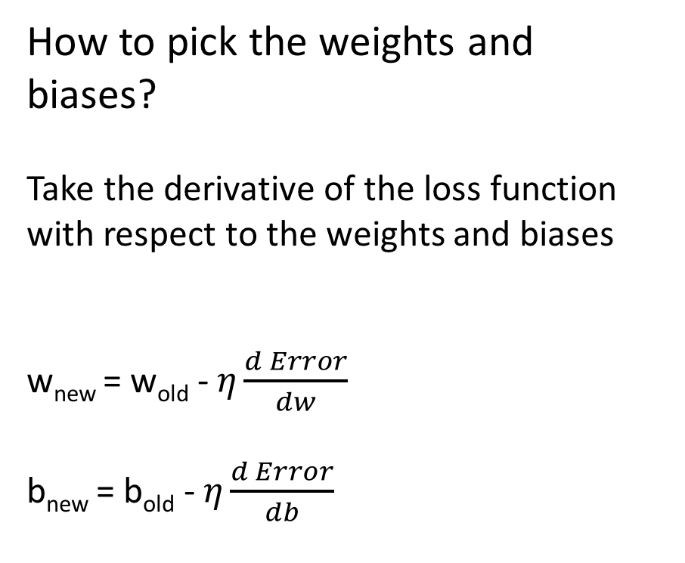
Information Processing in a VERY Simple Neural network
How to pick the weights and biases?
Take the derivative of the loss function with respect to the weights and biases
w_{new} = w_{old} -$η\frac{d Error}{dw}$
b_{new} = b_{old} -$η\frac{d Error}{db}$
Node₁
w₁
X
$$\left({0 \atop 1}\right)$$
Node₁ = f(w₁X + b)
Notes:
Backpropagation
Eta is a parameter called the learning rate. It controls how big of a step you take when traversing the loss function.
Update the weights with each training pair or until the loss is minimized
We will talk more about monitoring this process in the next seminar

Slide 27
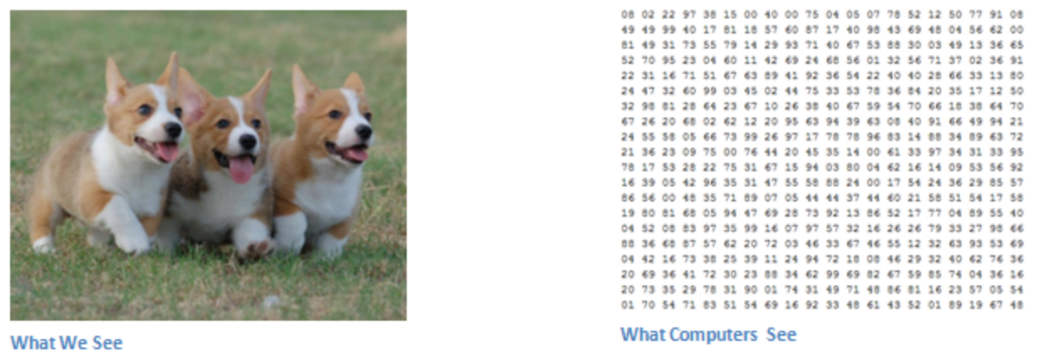
Applying Neural Networks to Images
Notes:
Most image based tasks involve recognition
For humans, this task of recognition is one of the first skills we learn from the moment we are born and is one that comes naturally and effortlessly as adults. Without even thinking twice, we’re able to quickly and seamlessly identify the environment we are in as well as the objects that surround us. When we see an image or just when we look at the world around us, most of the time we are able to immediately characterize the scene and give each object a label, all without even consciously noticing. These skills of being able to quickly recognize patterns, generalize from prior knowledge, and adapt to different image environments are ones that we do not share with our fellow machines
Inputs and Outputs
When a computer sees an image (takes an image as input), it will see an array of pixel values. Depending on the resolution and size of the image, it will see a 32 x 32 x 3 array of numbers (The 3 refers to RGB values). Just to drive home the point, let's say we have a color image in JPG form and its size is 480 x 480. The representative array will be 480 x 480 x 3. Each of these numbers is given a value from 0 to 255 which describes the pixel intensity at that point. These numbers, while meaningless to us when we perform image classification, are the only inputs available to the computer. The idea is that you give the computer this array of numbers and it will output numbers that describe the probability of the image being a certain class (.80 for cat, .15 for dog, .05 for bird, etc).
Too many parameters
Image that is 500x1000 pixels =

Slide 28
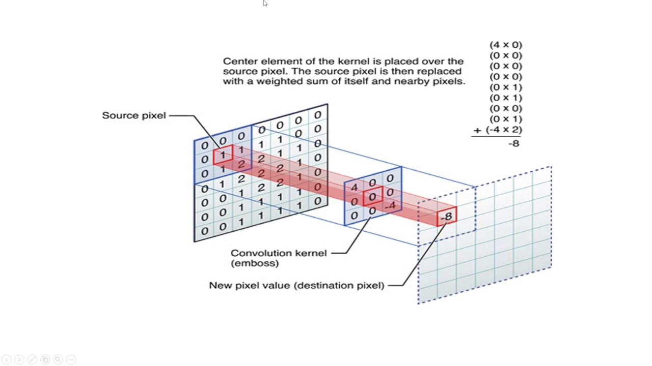
Convolutional Neural Networks
Convolutional Nodes/Layer
Node
Kernel/node
Node = f(w₁*x₁ + w₂*x₂ + … + w_{n}*x_{n} )
Notes:
The weights make up an array that is called a kernel/feature detector/filter
The first layer in a CNN is always a Convolutional Layer. First thing to make sure you remember is what the input to this conv (I’ll be using that abbreviation a lot) layer is. Like we mentioned before, the input is a 32 x 32 x 3 array of pixel values. Now, the best way to explain a conv layer is to imagine a flashlight that is shining over the top left of the image. Let’s say that the light this flashlight shines covers a 5 x 5 area. And now, let’s imagine this flashlight sliding across all the areas of the input image. In machine learning terms, this flashlight is called a filter(or sometimes referred to as a neuron or a kernel) and the region that it is shining over is called the receptive field. Now this filter is also an array of numbers (the numbers are called weights or parameters). A very important note is that the depth of this filter has to be the same as the depth of the input (this makes sure that the math works out), so the dimensions of this filter is 5 x 5 x 3. Now, let’s take the first position the filter is in for example. It would be the top left corner. As the filter is sliding, or convolving, around the input image, it is multiplying the values in the filter with the original pixel values of the image (aka computing element wise multiplications). These multiplications are all summed up (mathematically speaking, this would be 75 multiplications in total). So now you have a single number. Remember, this number is just representative of when the filter is at the top left of the image. Now, we repeat this process for every location on the input volume. (Next step would be moving the filter to the right by 1 unit, then right again by 1, and so on). Every unique location on the input volume produces a number. After sliding the filter over all the locations, you will find out that what you’re left with is a 28 x 28 x 1 array of numbers, which we call an activation map or feature map. The reason you get a 28 x 28 array is that there are 784 different locations that a 5 x 5 filter can fit on a 32 x 32 input image. These 784 numbers are mapped to a 28 x 28 array.

Slide 29
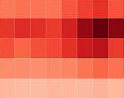
Convolutional Neural Networks
Convolutional Nodes/Layer
Node
Kernel
Activation Map
Kernel/node
Node = f(w₁*x₁ + w₂*x₂ + … + w_{n}*x_{n} )
Notes:
The weights make up an array that is called a kernel/feature detector/filter
The first layer in a CNN is always a Convolutional Layer. First thing to make sure you remember is what the input to this conv (I’ll be using that abbreviation a lot) layer is. Like we mentioned before, the input is a 32 x 32 x 3 array of pixel values. Now, the best way to explain a conv layer is to imagine a flashlight that is shining over the top left of the image. Let’s say that the light this flashlight shines covers a 5 x 5 area. And now, let’s imagine this flashlight sliding across all the areas of the input image. In machine learning terms, this flashlight is called a filter(or sometimes referred to as a neuron or a kernel) and the region that it is shining over is called the receptive field. Now this filter is also an array of numbers (the numbers are called weights or parameters). A very important note is that the depth of this filter has to be the same as the depth of the input (this makes sure that the math works out), so the dimensions of this filter is 5 x 5 x 3. Now, let’s take the first position the filter is in for example. It would be the top left corner. As the filter is sliding, or convolving, around the input image, it is multiplying the values in the filter with the original pixel values of the image (aka computing element wise multiplications). These multiplications are all summed up (mathematically speaking, this would be 75 multiplications in total). So now you have a single number. Remember, this number is just representative of when the filter is at the top left of the image. Now, we repeat this process for every location on the input volume. (Next step would be moving the filter to the right by 1 unit, then right again by 1, and so on). Every unique location on the input volume produces a number. After sliding the filter over all the locations, you will find out that what you’re left with is a 28 x 28 x 1 array of numbers, which we call an activation map or feature map. The reason you get a 28 x 28 array is that there are 784 different locations that a 5 x 5 filter can fit on a 32 x 32 input image. These 784 numbers are mapped to a 28 x 28 array.

Slide 30
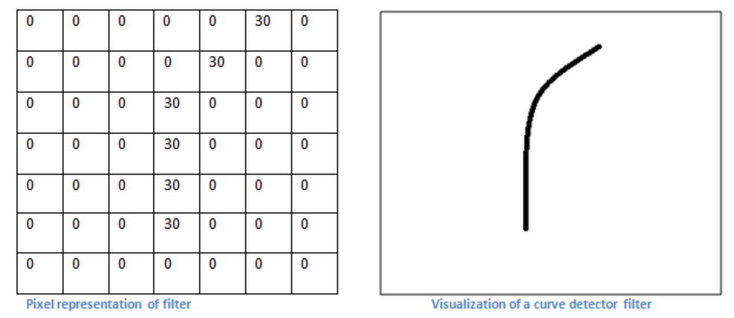
Convolutional Neural Networks
Convolutional Nodes/Layer
Notes:
As a curve detector, the filter will have a pixel structure in which there will be higher numerical values along the area that is a shape of a curve (Remember, these filters that we’re talking about as just numbers!).

Slide 31
Convolutional Neural Networks
Convolutional Nodes/Layer
Notes:
As a curve detector, the filter will have a pixel structure in which there will be higher numerical values along the area that is a shape of a curve (Remember, these filters that we’re talking about as just numbers!).

Slide 32
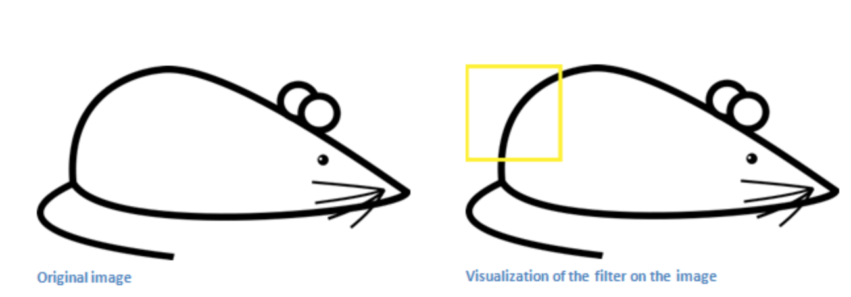
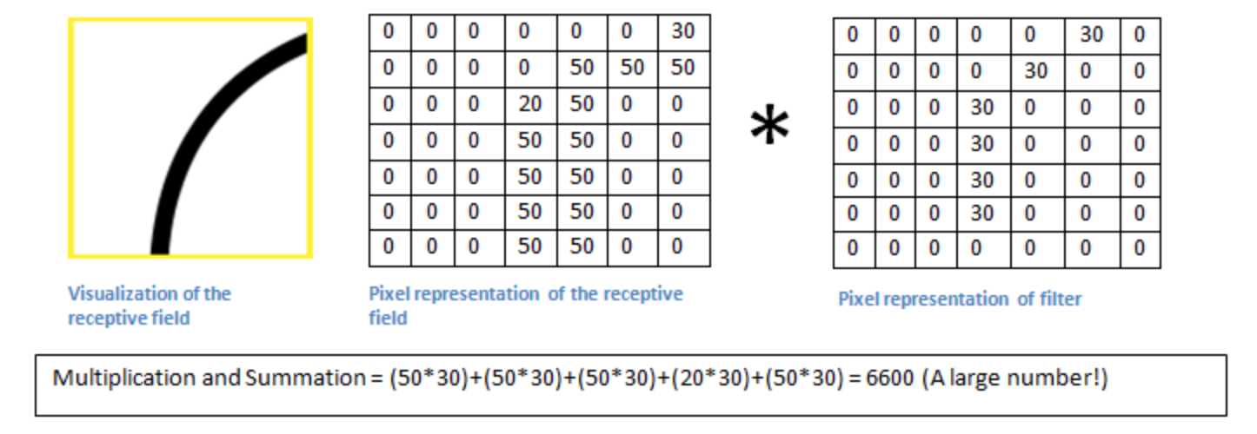
Convolutional Neural Networks
Convolutional Nodes/Layer
Notes:
When we have this filter at the top left corner of the input volume, it is computing multiplications between the filter and pixel values at that region. Now let’s take an example of an image that we want to classify, and let’s put our filter at the top left corner.
Remember, what we have to do is multiply the values in the filter with the original pixel values of the image.
Basically, in the input image, if there is a shape that generally resembles the curve that this filter is representing, then all of the multiplications summed together will result in a large value! Now let’s see what happens when we move our filter.

Slide 33
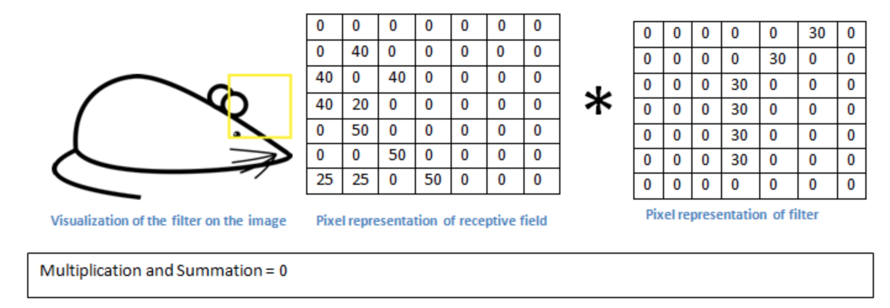
Convolutional Neural Networks
Convolutional Nodes/Layer
Notes:
Now let’s see what happens when we move our filter.
The value is much lower! This is because there wasn’t anything in the image section that responded to the curve detector filter. Remember, the output of this conv layer is an activation map. So, in the simple case of a one filter convolution (and if that filter is a curve detector), the activation map will show the areas in which there at mostly likely to be curves in the picture. In this example, the top left value of our 26 x 26 x 1 activation map (26 because of the 7x7 filter instead of 5x5) will be 6600. This high value means that it is likely that there is some sort of curve in the input volume that caused the filter to activate. The top right value in our activation map will be 0 because there wasn’t anything in the input volume that caused the filter to activate (or more simply said, there wasn’t a curve in that region of the original image). Remember, this is just for one filter. This is just a filter that is going to detect lines that curve outward and to the right. We can have other filters for lines that curve to the left or for straight edges. The more filters, the greater the depth of the activation map, and the more information we have about the input volume.

Slide 34
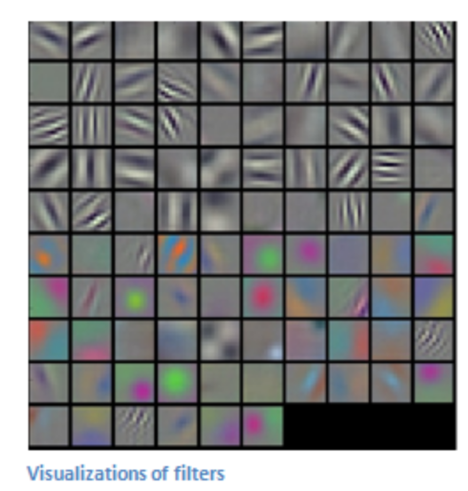
Convolutional Neural Networks
Convolutional Nodes/Layer

Slide 35
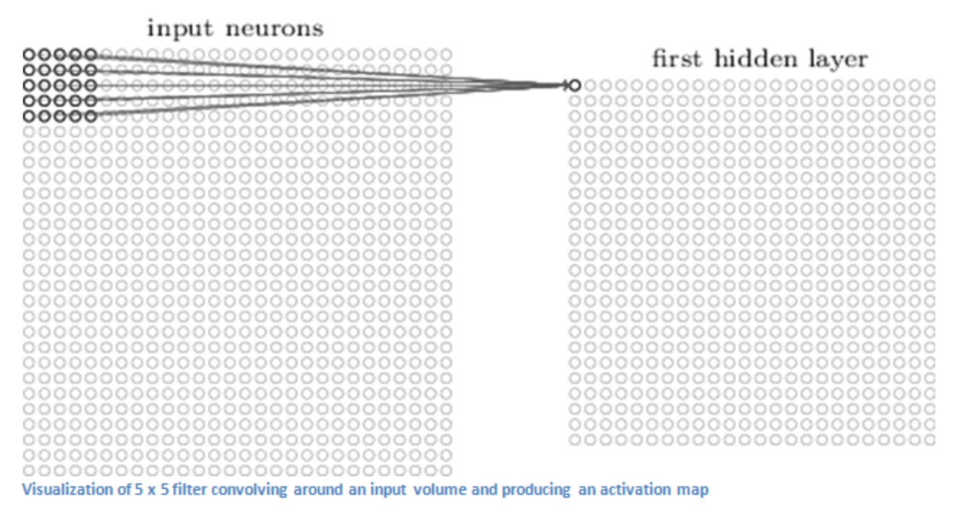
Convolutional Neural Networks
Convolutional Layer
Node
Node = f(w₁*x₁ + w₂*x₂ + … + w_{n}*x_{n} )
Notes:
The weights make up an array that is called a kernel/feature detector/filter
The first layer in a CNN is always a Convolutional Layer. First thing to make sure you remember is what the input to this conv (I’ll be using that abbreviation a lot) layer is. Like we mentioned before, the input is a 32 x 32 x 3 array of pixel values. Now, the best way to explain a conv layer is to imagine a flashlight that is shining over the top left of the image. Let’s say that the light this flashlight shines covers a 5 x 5 area. And now, let’s imagine this flashlight sliding across all the areas of the input image. In machine learning terms, this flashlight is called a filter(or sometimes referred to as a neuron or a kernel) and the region that it is shining over is called the receptive field. Now this filter is also an array of numbers (the numbers are called weights or parameters). A very important note is that the depth of this filter has to be the same as the depth of the input (this makes sure that the math works out), so the dimensions of this filter is 5 x 5 x 3. Now, let’s take the first position the filter is in for example. It would be the top left corner. As the filter is sliding, or convolving, around the input image, it is multiplying the values in the filter with the original pixel values of the image (aka computing element wise multiplications). These multiplications are all summed up (mathematically speaking, this would be 75 multiplications in total). So now you have a single number. Remember, this number is just representative of when the filter is at the top left of the image. Now, we repeat this process for every location on the input volume. (Next step would be moving the filter to the right by 1 unit, then right again by 1, and so on). Every unique location on the input volume produces a number. After sliding the filter over all the locations, you will find out that what you’re left with is a 28 x 28 x 1 array of numbers, which we call an activation map or feature map. The reason you get a 28 x 28 array is that there are 784 different locations that a 5 x 5 filter can fit on a 32 x 32 input image. These 784 numbers are mapped to a 28 x 28 array.

Slide 36
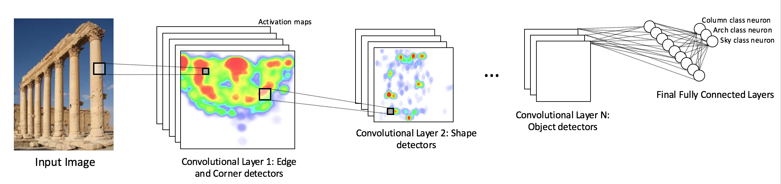
Convolutional Neural Networks
Convolutional Neural Network Architecture
Notes:
So each layer of the input is basically describing the locations in the original image for where certain low level features appear. Now when you apply a set of filters on top of that (pass it through the 2nd conv layer), the output will be activations that represent higher level features. Types of these features could be semicircles (combination of a curve and straight edge) or squares (combination of several straight edges). As you go through the network and go through more conv layers, you get activation maps that represent more and more complex features. By the end of the network, you may have some filters that activate when there is handwriting in the image, filters that activate when they see pink objects, etc.

Slide 37
Summary (so far)
Basic mathematical overview of deep neural networks
Important vocabulary
Hidden layers
nodes
Feature learning in fully connected neural networks
Activation functions/types of neurons
Basics of training: loss functions and backpropagation
Feature learning in convolutional neural networks
Notes:
So far we have focused on how the neural network structure influences how it learns and extracts information from the environment, now we are going to discuss a bit about the importance of the training dataset

Slide 38
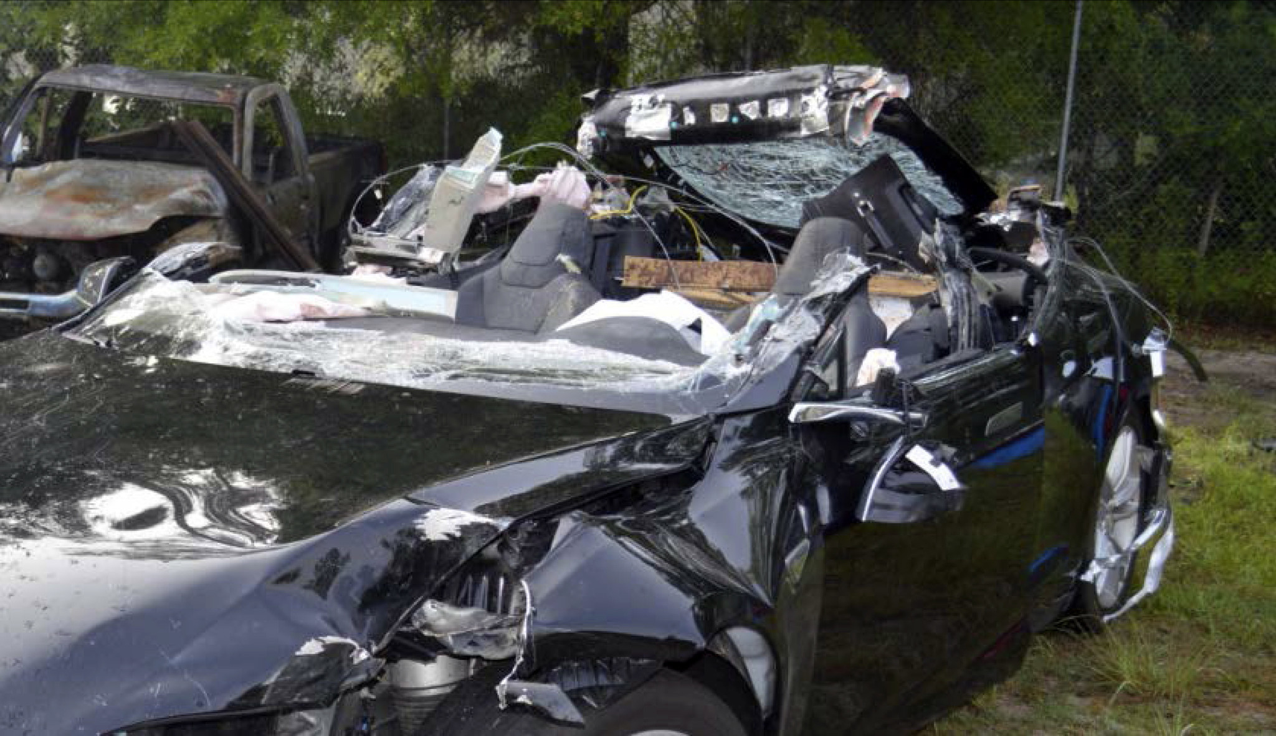
The first autonomous vehicle crash
The First Autonomous Vehicle crash
The system’s forward-looking camera failed to recognize a white truck against a bright sky
Why didn’t the vision system detect the truck?
Notes:
So why should we care about sensor effects???
Let’s consider the first fatal autonomous car crash, which involved a Tesla.
The driver was using the autopilot, and the car’s vision system, specifically the forward-facing camera sensor, failed to detect an oncoming white truck, which was cast against a bright sky.
The question is, why did the vision system fail to detect the truck in this scenario?
While the exact vision system used by Tesla’s Autopilot is proprietary, we do know that it utilizes a deep learning framework.
A way that we can start to understand why this system failed is to look at how images are used by a deep learning algorithm.

Slide 39
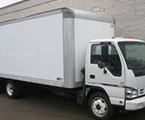
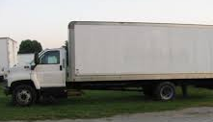
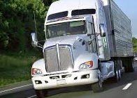
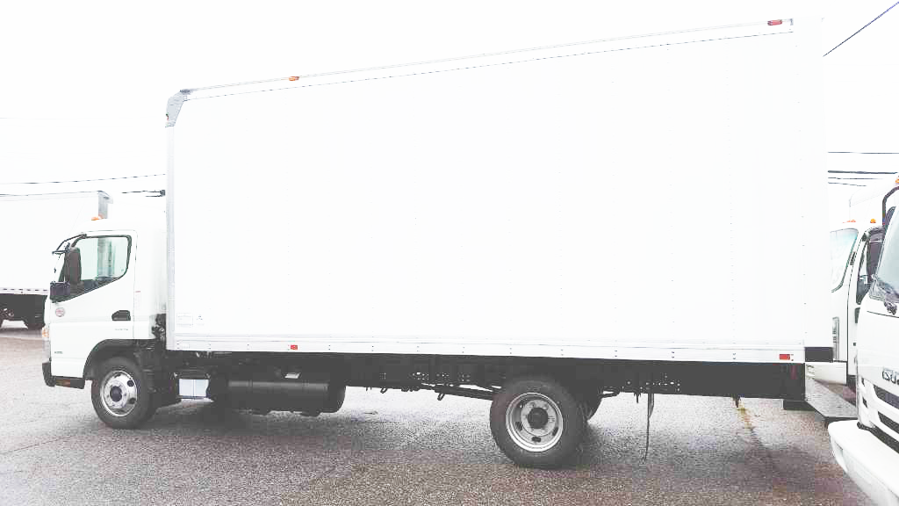
The Importance of a Good Training Dataset
The Importance of a good training dataset
TRAINING PROCEDURE:
Neural Network
Vehicle
Vehicle
Not Vehicle
TESTING PROCEDURE:
Neural Network
…
Not Vehicle
Notes:
So how does this learning process happen?
In training, a deep neural network is given images, which it learns to associate with correct labels.
Neural networks learn from its mistakes. During training, when the neural network incorrectly predicts or misinterprets an input, it is because some of the neural networks processing elements have the incorrect values and the algorithm produces the wrong answer.
So to learn to associate between input and output, the previously mentioned a values are changed to match the output label based upon the error
Ideally, we then could use this network on any test dataset.
However, the accuracy and quality of the mapping between images and is partially dependent upon what scene information that is captured in the training data.

Slide 40
Deep Learning in vision systems
Y = aX + b
Neural Network
Output Y
Vehicle/
Not Vehicle
Data Points
TESTING PROCEDURE:
Neural Network
…
Not Vehicle
Input X
Notes:
To understand where this dependency comes from and thus WHY DATASET MATTERS, consider the following scenario:
Red dotted line is the real relationship/mapping/truth that we want to learn, the black dots are points in our datasets.
As previously mentioned, a neural network learns to model a complicated function from the data its given.
However, if the data isnt sampled well (like we only capture a part of the possible Input X values)

Slide 41
Deep Learning in vision systems
Y = aX + b
Neural Network
Learned Model
Output Y
Vehicle/
Not Vehicle
Data Points
TESTING PROCEDURE:
Neural Network
…
Not Vehicle
Input X
Notes:
To understand WHY DATASET MATTERS, consider the following scenario:
Red dotted line is the real truth that we want to learn, the black dots are points in our datasets.
As previously mentioned, a neural network learns to model a complicated function from the data its given.
However, if the data isnt sampled well (like we only capture a part of the possible Input X values that arent representative of all possible values that x can take on, then we can learn a model that is bad.)

Slide 42
The Importance of a Good Training Dataset
The Importance of a good training dataset
TRAINING PROCEDURE:
Neural Network
Vehicle
Vehicle
Not Vehicle
TESTING PROCEDURE:
Neural Network
…
Not Vehicle
Notes:
So how does this learning process happen?
In training, a deep neural network is given images, which it learns to associate with correct labels.
Neural networks learn from its mistakes. During training, when the neural network incorrectly predicts or misinterprets an input, it is because some of the neural networks processing elements have the incorrect values and the algorithm produces the wrong answer.
So to learn to associate between input and output, the previously mentioned a values are changed to match the output label based upon the error
Ideally, we then could use this network on any test dataset.
However, the accuracy and quality of the mapping between images and is partially dependent upon what scene information that is captured in the training data.

Slide 43
The Importance of a good training dataset
TRAINING PROCEDURE:
Neural Network
Vehicle
Vehicle
Not Vehicle
TESTING PROCEDURE:
Neural Network
Not Vehicle
Notes:
So in the case of autonomous vehicles, For example, if a network is only trained on images of side-facing cars, it could have a more difficult time reliably generating a correct association if presented with a view of the back of a car.
So a potential cause of the detection failure in the tesla crash could be that the vision system could not generalize well to overexposed data.
This means that, if datasets are biased towards specific scene/environmental factors, the algorithm could be as well.
A similar argument can be made for unsupervised learning, which for us refers to generative neural networks that take in information in some form and output images. Without a dataset that has a lot of variance in real world appearance, it will produce images that do not capture the real world.

Slide 44
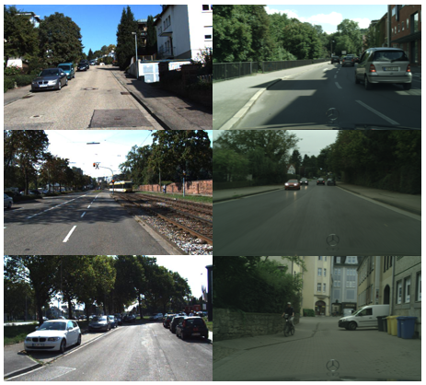
The Importance of a good training dataset
What visual information exists in real datasets?
Types of scene structure:
Viewpoint
Lighting/Time of day
Spatial structure
Pixel Statistics:
Tone/Color Cast
Noise and Distortion Patterns
Saturation
Correlations between Color Channels
What role does the sensor/camera model have?
KITTI
Cityscapes
Notes:
So what visual features do we want represented in our datasets? The two datasets shown on the right, KITTI and Cityscapes, are both benchmark vehicle datasets.
Benchmark means that the vision community uses these datasets as standards for evaluating performance of new algorithms.
KITTI consists of approx. 7500 training images which are captured by driving around the mid-size city of Karlsruhe, Germany, in small neigborhoods and on highways.
Cityscapes is a dataset designed for semantic understanding of urban street scenes, which includes detection. It has ~2500 annotated training images taken in 50 cities in Germany.
In terms of possible variations, these two datasets are highly similar; both are taken during similar times of day, in similar weather and seasons, in similar cities in Germany, and focused on imaging cars in an urban environment (same camera orientation towards the road).

Slide 45
The Importance of a good training dataset
What visual information exists in real datasets?
Types of scene structure:
Viewpoint
Shadows (Lighting/Time of day)
Buildings, Road, etc (Spatial structure)
Pixel Statistics:
Tone/Color Cast
Noise and Distortion Patterns
Saturation
Correlations between Color Channels
What role does the sensor/camera model have?
KITTI
Cityscapes
Notes:
Let’s discuss this idea of generalizability and robustness in the context of real vehicle datasets. The two datasets shown on the right, KITTI and Cityscapes, are both benchmark vehicle datasets.
Benchmark means that the vision community uses these datasets as standards for evaluating performance of new algorithms.
KITTI consists of approx. 7500 training images which are captured by driving around the mid-size city of Karlsruhe, Germany, in small neigborhoods and on highways.
Cityscapes is a dataset designed for semantic understanding of urban street scenes, which includes detection. It has ~2500 annotated training images taken in 50 cities in Germany.
In terms of possible variations, these two datasets are highly similar; both are taken during similar times of day, in similar weather and seasons, in similar cities in Germany, and focused on imaging cars in an urban environment (same camera orientation towards the road).

Slide 46
The Importance of a good training dataset
What visual information exists in real datasets?
Types of scene structure:
Viewpoint
Shadows (Lighting/Time of day)
Buildings, Road, etc (Spatial structure)
Pixel Statistics:
Tone/Color Cast
Noise and Distortion Patterns
Saturation/Exposure
Correlations between Color Channels
What role does the sensor/camera model have?
KITTI
Cityscapes
Notes:
Lighting/Time of day/shadows
Distortion patters (weather)
Lets discuss this idea of generalizability and robustness in the context of real vehicle datasets. The two datasets shown on the right, KITTI and Cityscapes, are both benchmark vehicle datasets.
Benchmark means that the vision community uses these datasets as standards for evaluating performance of new algorithms.
KITTI consists of approx. 7500 training images which are captured by driving around the mid-size city of Karlsruhe, Germany, in small neigborhoods and on highways.
Cityscapes is a dataset designed for semantic understanding of urban street scenes, which includes detection. It has ~2500 annotated training images taken in 50 cities in Germany.
In terms of possible variations, these two datasets are highly similar; both are taken during similar times of day, in similar weather and seasons, in similar cities in Germany, and focused on imaging cars in an urban environment (same camera orientation towards the road).

Slide 47
The Importance of a good training dataset
REAL WORLD
Notes:
So if we consider the space of real world scene factors (represented by the blue circle) that can impact the learning process in neural networks, sensor effects would be included because they can alter the appearance of the world.
Each real dataset captures a subset of these possible real world scenarios.
We can see through this example that the smaller the variance of the scene factors represented in a dataset, the further away it is from other datasets in this space, and hence, how less robust it is to different scenes when tested on novel data.
We would like to develop methods that bridge the gap between these worlds that would allow us to capture more real world variance (ie, more real world scenes) that would allow a deep learning algorithm trained in the ‘KITTI world’ to be deployed with no performance decrease in any other ‘dataset world’.

Slide 48
The Importance of a good training dataset
Over Exposed White Truck
REAL WORLD
KITTI
KITTI
White Trucks
Truck Images
Cityscapes
Cityscapes
Notes:
So if we consider the space of real world scene factors (represented by the blue circle) that can impact the learning process in neural networks, sensor effects would be included because they can alter the appearance of the world.
Each real dataset captures a subset of these possible real world scenarios.
We can see through this example that the smaller the variance of the scene factors represented in a dataset, the further away it is from other datasets in this space, and hence, how less robust it is to different scenes when tested on novel data.
We would like to develop methods that bridge the gap between these worlds that would allow us to capture more real world variance (ie, more real world scenes) that would allow a deep learning algorithm trained in the ‘KITTI world’ to be deployed with no performance decrease in any other ‘dataset world’.

Slide 49
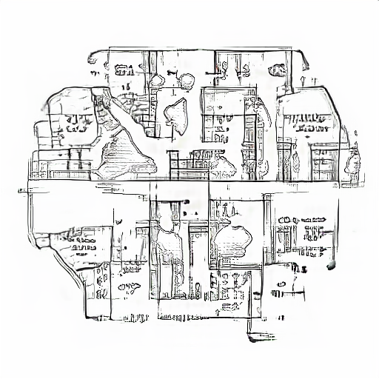
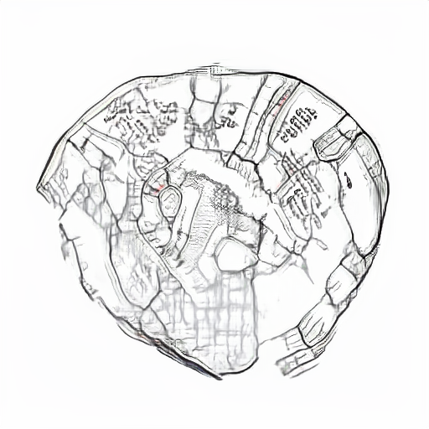
How can we use this to our advantage?
We can design datasets that influence the learned features of the neural network
Notes:
Series of iterations of the CNN in regards of columns, or marble.
Applying a visualization technique similar to google deep dream, we can visualize the spatial/visual features that maximally activate a particular class for a network trained on image classification (the method is discussed in more detail in the methods). The above images were generated from a CNN trained upon the ImageNet dataset, which is over a million images and is labeled for over 1600 classes, which includes ‘triumphal arch’, ‘fountain’, and ’park bench’. It is the dataset that ‘best approximates’ the real world due to its sheer size.

Slide 50
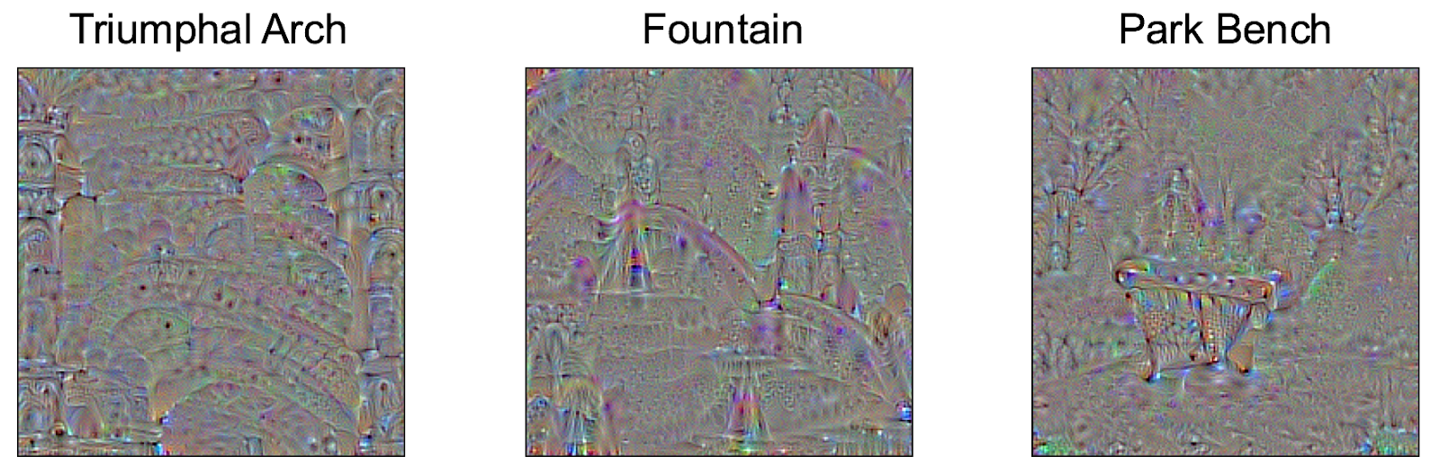
How can we use this to our advantage?
We can design datasets that influence the learned features of the neural network
Notes:
Series of iterations of the CNN in regards of columns, or marble.
Applying a visualization technique similar to google deep dream, we can visualize the spatial/visual features that maximally activate a particular class for a network trained on image classification (the method is discussed in more detail in the methods). The above images were generated from a CNN trained upon the ImageNet dataset, which is over a million images and is labeled for over 1600 classes, which includes ‘triumphal arch’, ‘fountain’, and ’park bench’. It is the dataset that ‘best approximates’ the real world due to its sheer size.

Slide 51
Summary
Basic mathematical overview of deep neural networks
Important vocabulary
Hidden layers
nodes
Feature learning in fully connected neural networks
Activation functions/types of neurons
Basics of training: loss functions and backpropagation
Feature learning in convolutional neural networks
The importance of training data
Notes:
So far we have focused on how the neural network structure influences how it learns and extracts information from the environment, now we are going to discuss a bit about the importance of the training dataset

Slide 52
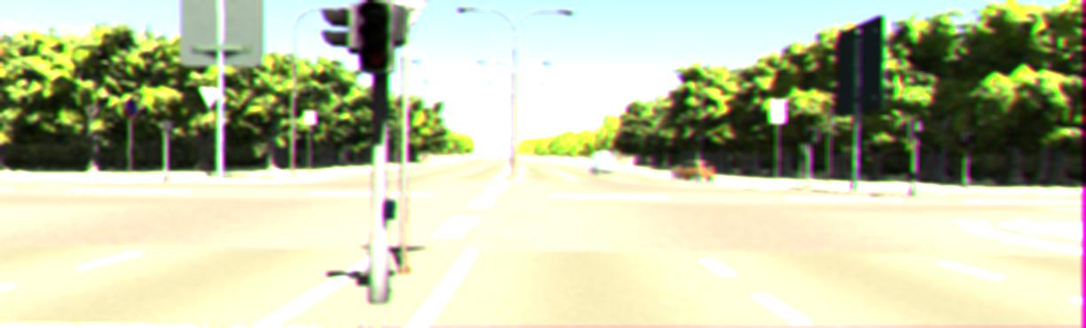
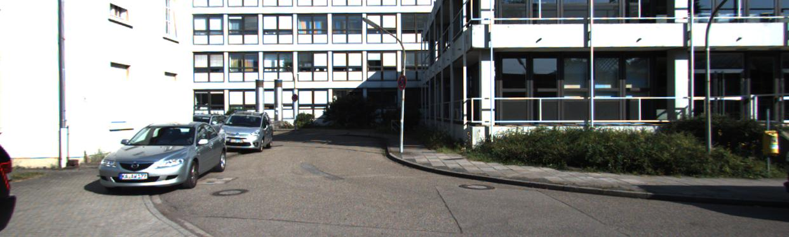
GANs
We are going to train a Generative adversarial network in the cloud!
What is a GAN?
Rendered Image
Real Image
Input Noise Vector
Generator Neural Network
Discriminator
Neural
Network
Real or Rendered
Notes:
A GAN is a type of generative neural network, which means that it generates a form a output, which is typically images.
A GAN is actually two neural networks: a Generator network and Discriminator network.

Slide 53
GANs
We are going to train a Generative adversarial network in the cloud!
What is a GAN?
Rendered Image
Target Image
Input Noise Vector
Generator Neural Network
Discriminator
Neural
Network
Real or Rendered
Notes:
A GAN is a type of generative neural network, which means that it generates a form a output, which is typically images.
A GAN is actually two neural networks: a Generator network and Discriminator network.

Slide 54
GANs
We are going to train a Generative adversarial network in the cloud!
What is a GAN?
Rendered Image
Target Image
Input Noise Vector
Generator Neural Network
Discriminator
Neural
Network
Real or Rendered
Notes:
A GAN is a type of generative neural network, which means that it generates a form a output, which is typically images.
A GAN is actually two neural networks: a Generator network and Discriminator network.
The generator is trained based upon the discriminator, and the discriminator is trained by the generator.
What results is a generator that has learned to make realistic images because it learns the distribution over real images.

Slide 55
Lecture II: Tips and tricks to training a deep neural network
I. How to define your task/problem in a deep learning framework:
Choosing the right neural network (Choosing the right loss function)
Choosing the right dataset (dataset composition and synthetic data)
Choosing the right hyper parameters
How to build in expert knowledge into your deep learning framework (e.g., conditional GANs)
II. How to monitor your training process and validation:
Choosing the right deep learning framework (e.g., tensor flow, mxnet)
Tensorboard Tutorial
III. Training CNNs as a case study

Slide 56
Lecture III: Applying deep learning algorithms and Case Studies
Basics of designing task-specific neural networks
— hand-building loss functions (distance metrics based on style, emotion, etc)
— using multiple types of input data/domains as a form of conditioning (e.g., GANs)
I. Google DeepDream/network dissection
II. Image to image translation networks, style transfer networks
III. Mixing graphs and neural networks (learning conditional relationships between objects in a task)

